Slide 1
AI Meets Query Optimization
Luming Sun @ DW&BI
2022/9/16

Slide 2
AI4DB Database system & Data Management Powered by Artificial Intelligence

Slide 3
AI + DB
AI:
Advance in CV, NLP, …
Statistic, learning, inference, planning
DB:
Static
Data volume, sophisticated workload, hardware
AI4DB
Goal: Reduce labor costs & Improve system performance
Query workload, data distribution, hardware features, history performance

Slide 4
Artificial Intelligence for System
Jiannan Wang, Machine Learning for Data Intensive Systems

Slide 5
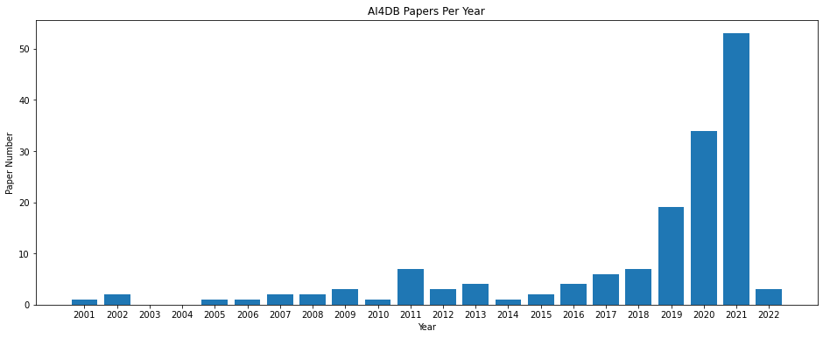
AI4DB Paper List https://github.com/LumingSun/ML4DB-paper-list

Slide 6
AI4DB
Andy Pavlo, et all. CIDR’17
Tim Kraska, et all. SIGMOD’18
Guoliang Li, et all. SIGMOD’19
Ryan Marcus, et all. SIGMOD’21

Slide 7
AI4DB
数据库
负载分析
查询语言处理
数据库
参数配置
自然语言与SQL
SQL Embedding
查询执行
自适应查询处理
查询调度管理
查询
负载
预测
参数
调优
查询优化
查询规模估算
查询代价估算
连接排序优化
查询计划生成
数据存取
数据分区
索引结构
索引推荐
孙路明, 张少敏, 姬涛, 李翠平, & 陈红. (2019). 人工智能赋能的数据管理技术研究. 软件学报, 31(3), 600-619.
Notes:
AIDB结合方式

Slide 8
Query Optimization Query optimizer is at the heart of the database systems

Slide 9
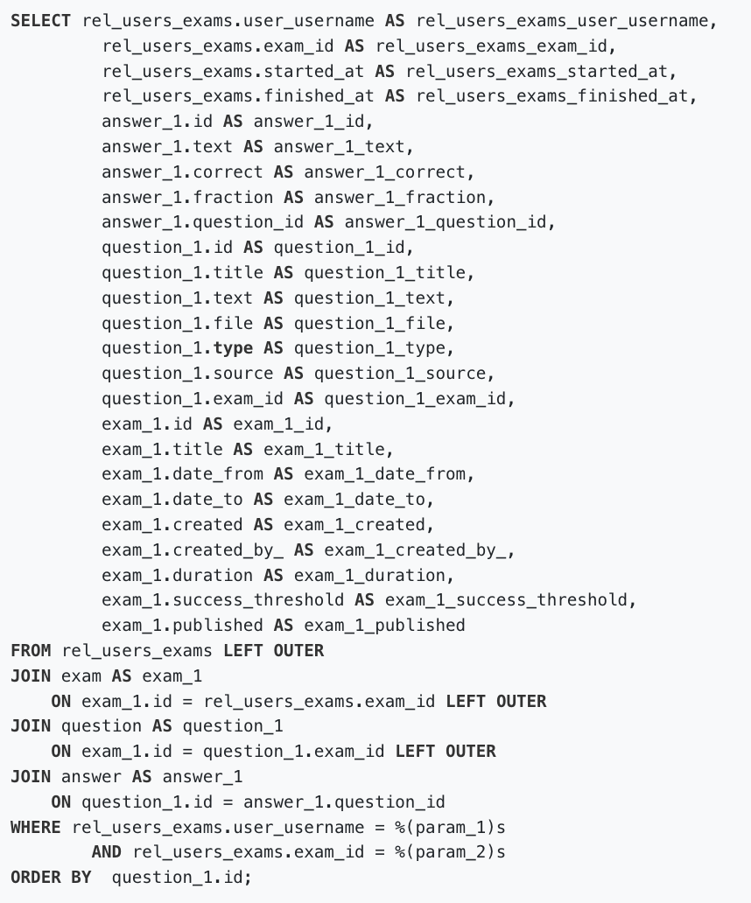
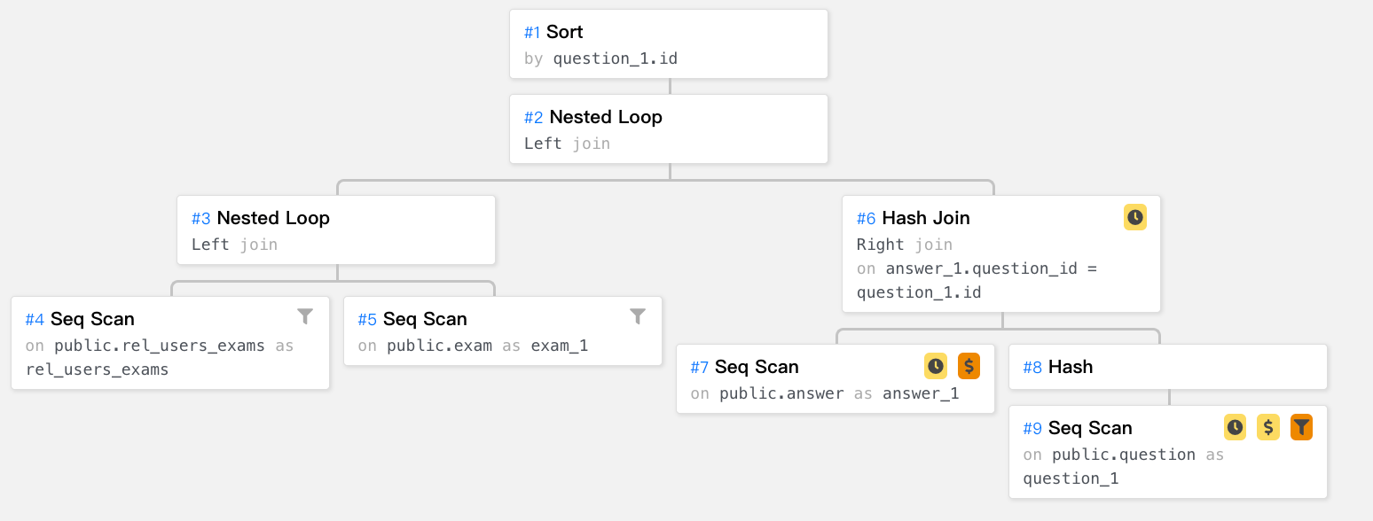
Query Optimization

Slide 10
Cost-based optimizer
A cost-based optimizer introduces a plan enumeration algorithm to find a (sub)plan, and then uses a cost model to obtain the cost of that plan, and selects the plan with the lowest cost.
In the cost model, cardinality, the number of tuples through an operator, plays a crucial role.

Slide 11
Cost-based optimizer
Key components | Traditional Methods | Advantages | Challenges
Cardinality estimation | Histogram | Space & computation friendly | Making assumptions about data distribution and attribute correlation
 | Sampling | Confidence property Workload shift | High selective predicates One fits all
Cost estimation | Complex function | Space & computation friendly | Various hardware Concurrent queries
Plan enumeration | Bottom-up (DP) Top-down (memorization) | Rules such as left-deep Pruning and interesting order | NP-hard Large number of tables
Notes:
conclude that there does not exist one sampling method suitable for all cases.

Slide 12
Why learning-based methods can help?
Machine Learning can be used in:
Modeling data distribution & data correlation
Optimize function parameter
Markov decision process

Slide 13
Cardinality/Selectivity Estimation

Slide 14
Why Cardinality/Selectivity Estimation
2014
“The root of all evil, the Achilles Heel of query optimization, is the estimation of the size of intermediate results, known as cardinalities.”
2015
“We have also shown that relational database systems produce large estimation errors that quickly grow as the number of joins increases, and that these errors are usually the reason for bad plans.”
2018
-
2021
Multiple research groups consistently working on learned selectivity estimators
Jiannan Wang, Machine Learning for Data Intensive Systems

Slide 15
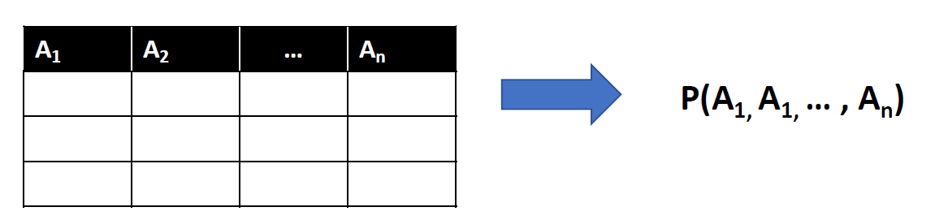
How Learned Selectivity Estimators Work
Methodology 1: Query-driven
Key Idea: Model as a Regression problem
Query Feature Vector Selectivity
Methodology 2: Data-driven
Key Idea: Model as a Joint Distribution Estimation problem
Feature Engineering
ML Models
Jiannan Wang, Machine Learning for Data Intensive Systems

Slide 16
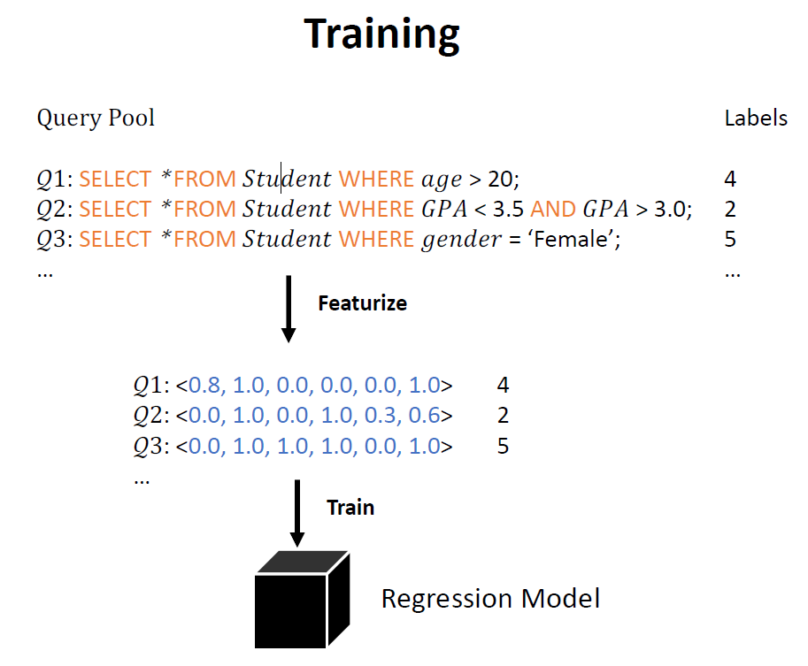
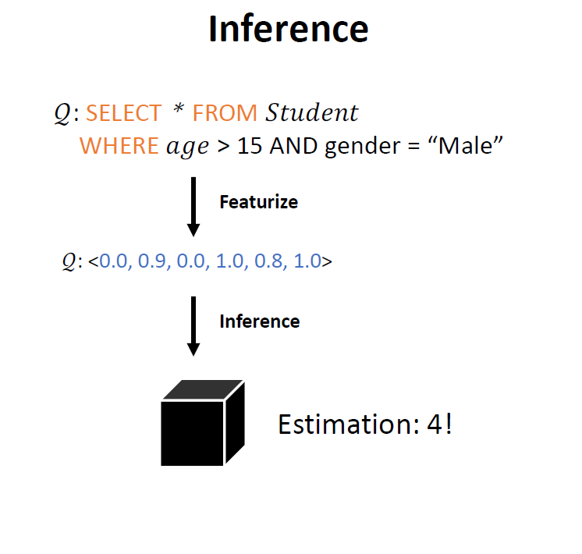
Methodology 1: Query-Driven
Jiannan Wang, Machine Learning for Data Intensive Systems

Slide 17
Methodology 1: Query-Driven
Single table:
• LW-XGB [Dutt, A et all. VLDB 19]
XGBoost+ Heuristic statistics
• LW-NN [Dutt, A et all. VLDB 19]
NN+ Heuristic statistics
• QuickSel [Yongjoo, P et all. SIGMOD 20]
Mixture Model

Slide 18
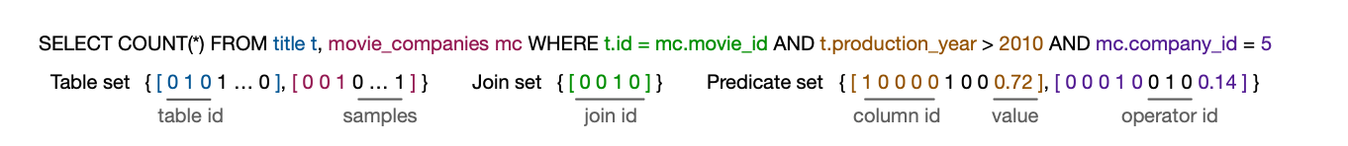
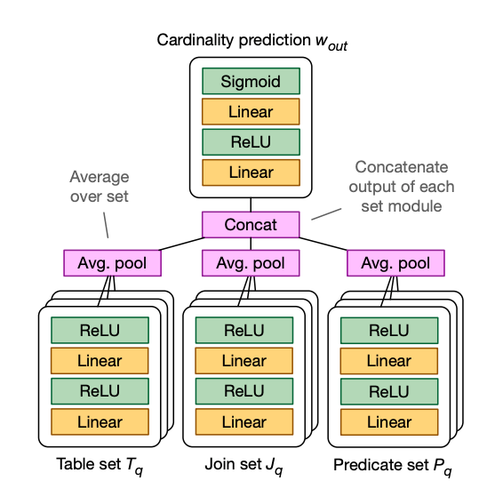
Methodology 1: Query-Driven
Multiple tables:
• LW-XGB [Dutt, A et all. VLDB 20]
XGBoost + incremental data gen
MSCN [Kipf, A et all. CIDR 19]
Neural Network + Sampling

Slide 19
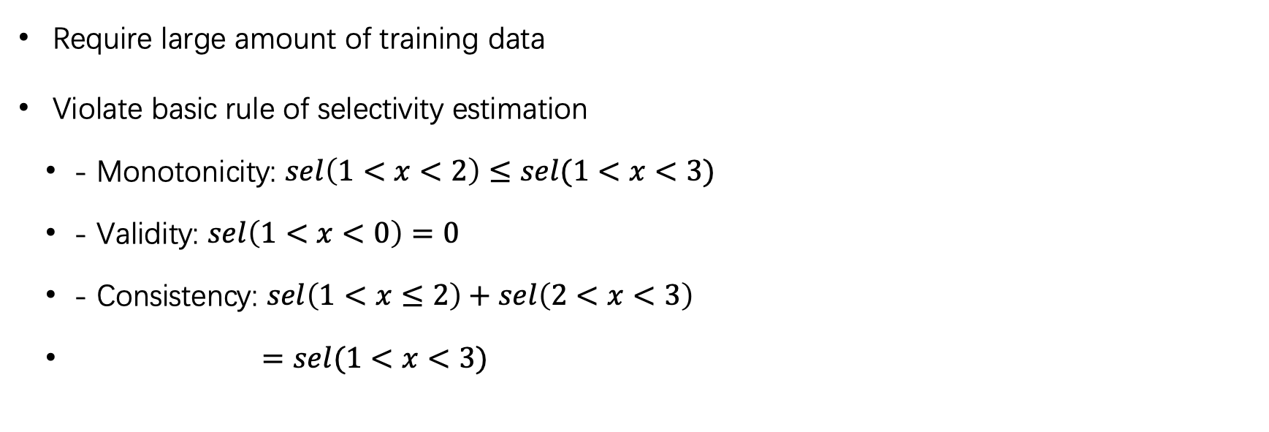
Query-Driven Shortcomings:
Require large amount of training data
Violate basic rule of selectivity estimation
- Monotonicity: $sel\left(1<x<2\right)≤sel(1<x<3)$
- Validity: $sel\left(1<x<0\right)=0$
- Consistency: $sel\left(1<x≤2\right)+sel\left(2<x<3\right)$
$=sel(1<x<3)$

Slide 20
How Learned Selectivity Estimators Work
Methodology 1: Query-driven
Key Idea: Model as a Regression problem
Query Feature Vector Selectivity
Methodology 2: Data-driven
Key Idea: Model as a Joint Distribution Estimation problem
Feature Engineering
ML Models
Jiannan Wang, Machine Learning for Data Intensive Systems

Slide 21
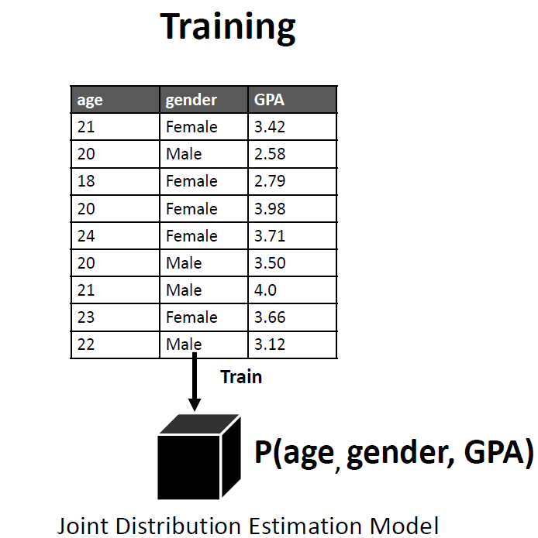
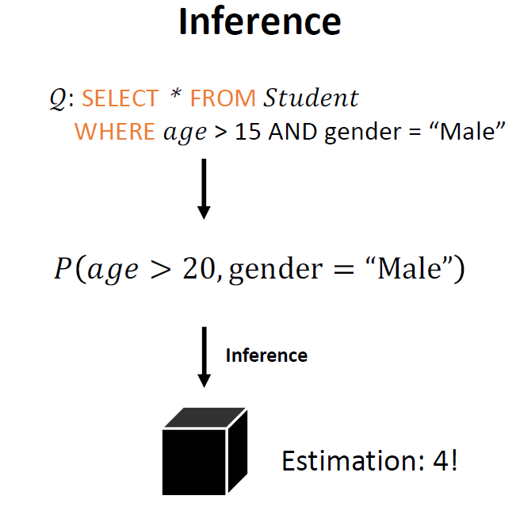
Methodology 2: Data-Driven
Jiannan Wang, Machine Learning for Data Intensive Systems

Slide 22
Methodology 2: Data-Driven
• Naru [Yang, Z et all. VLDB 20]
Auto-regressive Model
• DeepDB [Hilprecht, B et all. VLDB 20]
Sum Product Network
(Graphical Model)
FACE [Wang, J et all. VLDB 2022]
Normalizing Flow

Slide 23
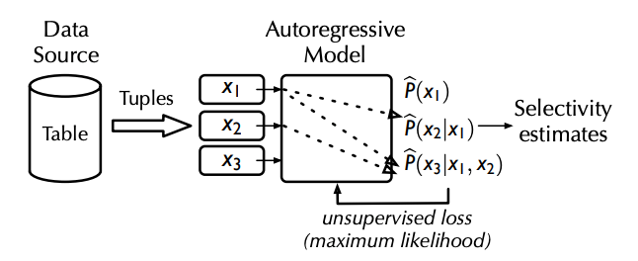
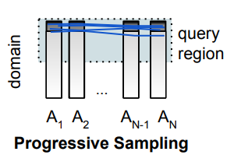
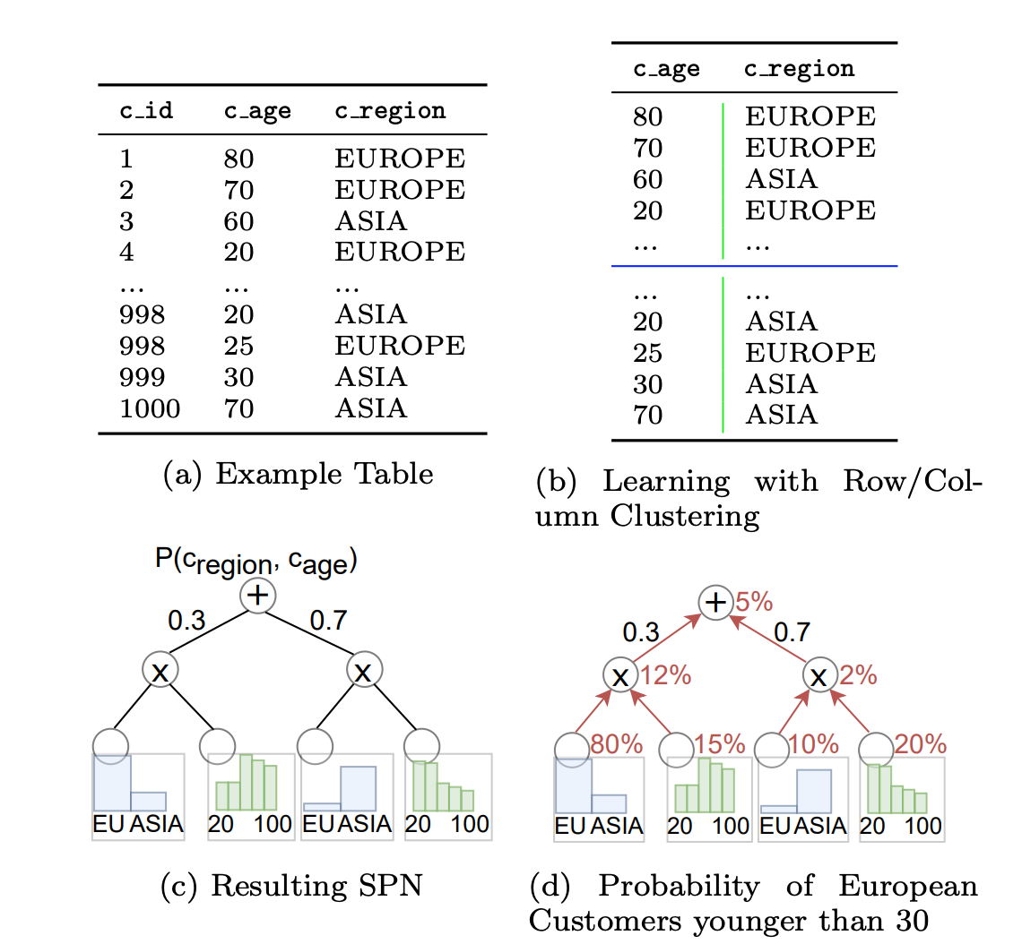
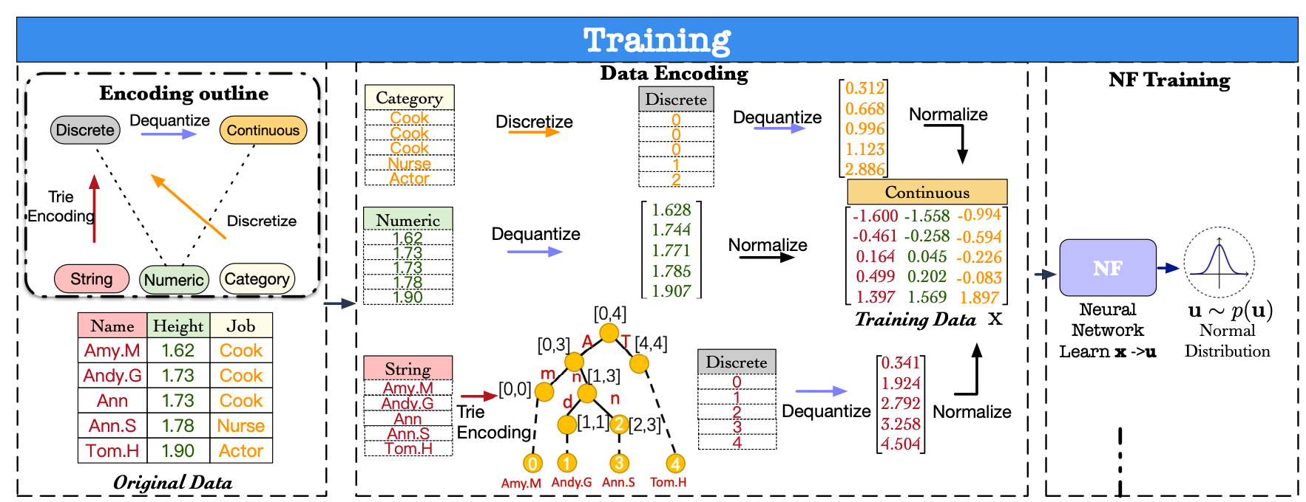
Data-Driven Methods
Naru: Auto-regressive model
FACE: Normalizing flow
DeepDB: Sum-product network

Slide 24
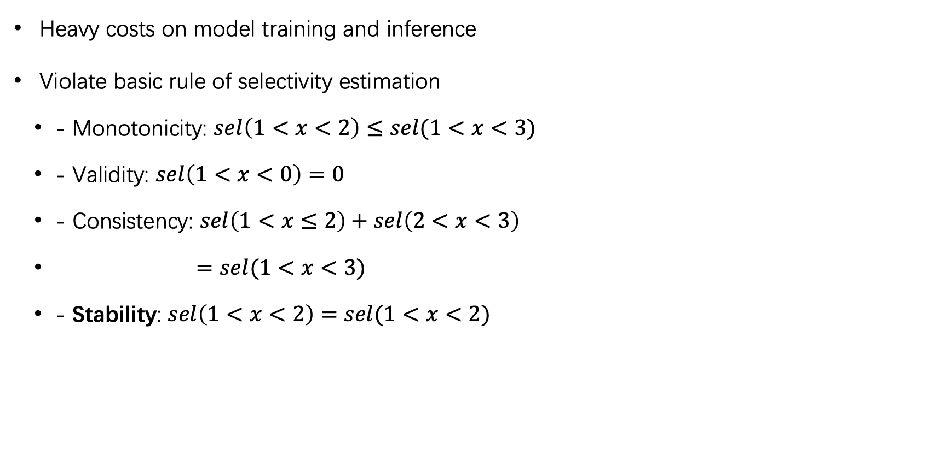
Shortcomings
Heavy costs on model training and inference
Violate basic rule of selectivity estimation
- Monotonicity: $sel\left(1<x<2\right)≤sel(1<x<3)$
- Validity: $sel\left(1<x<0\right)=0$
- Consistency: $sel\left(1<x≤2\right)+sel\left(2<x<3\right)$
$=sel(1<x<3)$
- Stability: $sel\left(1<x<2\right)=sel(1<x<2)$

Slide 25
MOSE: A Monotonic Selectivity Estimator Using Learned CDF
Aim
Reliable, accurate and efficient learned selectivity estimator
Problem Settings
Multi-dimensional predicates on single table
Methodology
Query-based
Key observation
The joint cumulative distribution function (CDF) of the data in a table can be used to compute the selectivity for query range predicates

Slide 26
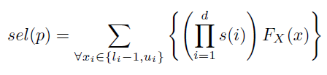
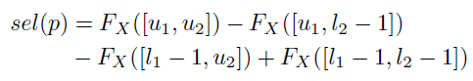
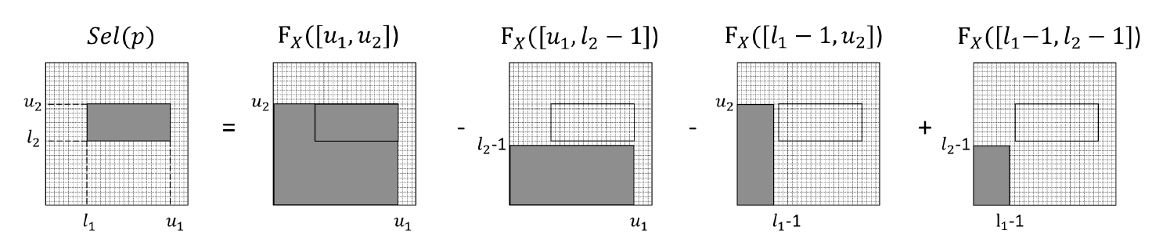
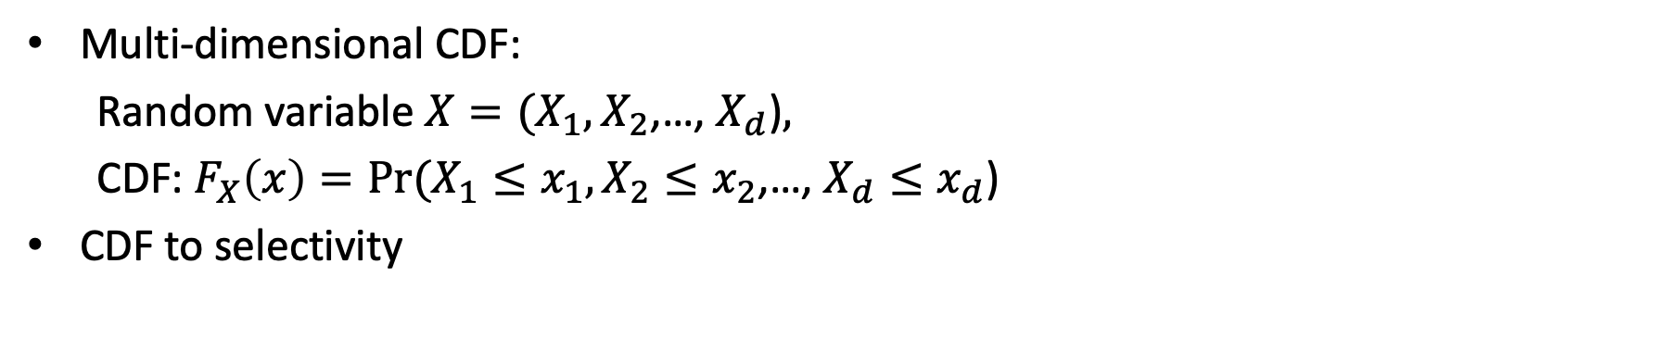
CDF to Selectivity
Multi-dimensional CDF:
Random variable $X=(X_{1},X_{2}$,…, $X_{d}$)$,$
CDF: $F_{X}\left(x\right)=Pr(X_{1}≤x_{1},X_{2}≤x_{2}$,…, $X_{d}≤x_{d}$)
CDF to selectivity

Slide 27
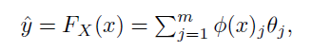
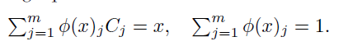
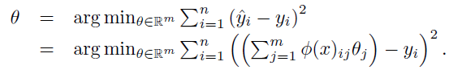
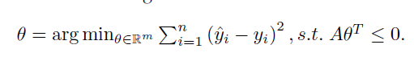
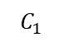
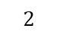
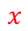
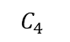
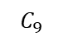
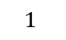
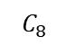

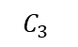
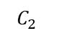
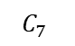
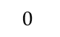
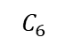
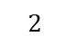
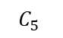
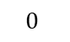
CDF Learner
Monotonic Lattice Regression Model
$$2$$
$$C_{7}$$
$$C_{8}$$
$$C_{9}$$
$$∙$$
$$x$$
$$1$$
$$C_{4}$$
$$C_{5}$$
$$C_{6}$$
$$0$$
$$C_{1}$$
$$C_{2}$$
$$C_{3}$$
$$0$$
$$1$$
$$2$$
C: Lattice Node
Theta: Lattice Parameter

Slide 28
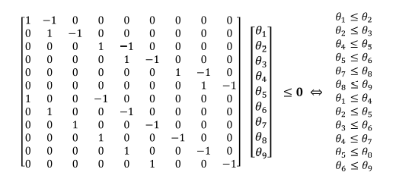
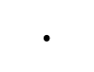
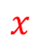
Monotonic Constrain
$$2$$
$$C_{7}$$
$$C_{8}$$
$$C_{9}$$
$$∙$$
$$x$$
$$1$$
$$C_{4}$$
$$C_{5}$$
$$C_{6}$$
$$0$$
$$C_{1}$$
$$C_{2}$$
$$C_{3}$$
$$0$$
$$1$$
$$2$$
C: Lattice Node
Theta: Lattice Parameter

Slide 29
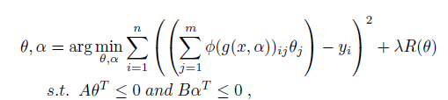
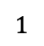
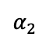
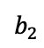
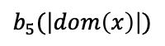
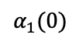
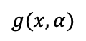
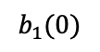








Attribute-Aware Calibration
$$g(x,α)$$
$$α_{5}(2)$$
$$·$$
Calibrated output
$$α_{4}$$
$$α_{3}$$
$$·$$
$$1$$
$$α_{2}$$
$$α_{1}(0)$$
$$x$$
$$b_{1}(0)$$
$$b_{2}$$
$$b_{3}$$
$$b_{4}$$
$$b_{5}(\left|dom\left(x\right)\right|)$$

Slide 30



Cell-Wise Regularizer
$$2$$
$$C_{7}$$
$$C_{8}$$
$$C_{9}$$
$$∙$$
$$x$$
$$1$$
$$C_{4}$$
$$C_{5}$$
$$C_{6}$$
$$0$$
$$C_{1}$$
$$C_{2}$$
$$C_{3}$$
$$0$$
$$1$$
$$2$$

Slide 31















Lattice Ensemble
Attributes subsets
Mutual information
$$A_{1}$$
$$A_{2}$$
$$A_{3}$$
Lattice model 1
$$A_{4}$$
$$A_{5}$$
$$A_{6}$$
Lattice model 2
Dataset
Attributes partition
$$A_{1}$$
$$A_{7}$$
$$A_{8}$$
Lattice model 3
Linear aggregation
Estimation
$$A_{7}$$
$$A_{2}$$
$$A_{4}$$
Lattice model 4
$$A_{9}$$
$$A_{2}$$
$$A_{10}$$
Lattice model 5

Slide 32
ACTIVE DATA GENERATOR
Challenges:
Infinite query space (NOT pool based active learning)
Regression problem (NO model uncertainty)
Solution
Picking the lattice cells that are most valuable or necessary to optimize
Two factors: (1) cell accuracy; (2) cell density
Weighted lattice sampling

Slide 33




Weighted Lattice Sampling
$M_{c}$: points in cell C
$k_{c}$: k points of C are in the
TOP-K worst estimation

Slide 34


Accuracy

Slide 35

Ablation Experiments

Slide 36
Active Learning

Slide 37
Model Size

Slide 38
Takeaways
Learning-based methods can be accurate, efficient, lightweight
But
Have longer-training time
May fail to catch up fast data change
Hard to trust
Are not practical in production
https://www.cs.sfu.ca/~jnwang/ppt/learned-cardinality-estimation.pdf

Slide 39
Cost Estimation

Slide 40
Learning-Based Cost Estimation
Single-query
SQL query based
Query plan based
Concurrency
Plan level
Operator level
combined
Combined
Hardware-based
Semantic-based
Block I/O
Cache statistics
Model alternative
Quality improving

Slide 41


Cost model in PostgreSQL

Slide 42

Plan-Structured Deep Neural Network Models for Query Performance Prediction (VLDB 2019)
Plan-structured cost learner

Slide 43


An End-to-End Learning-based Cost Estimator (VLDB 2019)
Plan-structured cost learner
Neo: A Learned Query Optimizer (VLDB 2019)

Slide 44
Takeaways
Learning-based cost estimation are accurate but not so efficient.
Some learning-based cost estimation methods are used for scheduling not query optimization.
Learning-based cost estimation (especially tree-structured) are not so practical in traditional cost-based query optimization.

Slide 45
Plan enumeration

Slide 46


Query Plan Optimization
Agent
State
Reward
Action
Environment
Optimizer
Subplan structure,
Query info
Cost
Join order,
Physical operator
Cost estimator

Slide 47



Query Plan Optimization
Krishnan, Sanjay, et al. "Learning to optimize join queries with deep reinforcement learning." arXiv preprint arXiv:1808.03196 (2018).
Marcus, Ryan, and Olga Papaemmanouil. "Deep reinforcement learning for join order enumeration." Proceedings of the First International Workshop on Exploiting Artificial Intelligence Techniques for Data Management (2018): 3.
Ortiz, Jennifer, et al. "Learning state representations for query optimization with deep reinforcement learning." arXiv preprint arXiv:1803.08604 (2018).
Marcus, Ryan and Olga Papaemmanouil. "Towards a hands-free query optimizer through deep learning. " (CIDR 2019).
Marcus, Ryan, et al. "Neo: A learned query optimizer." (VLDB 2019).

Slide 48
Shortcomings
Long training time
Inability to adjust to data and workload changes
Tail catastrophe
Black-box decisions
Integration cost

Slide 49



Bao: Making Learned query Optimization Practical (SIGMOD 2021 Best Paper)

Slide 50



Bao: Making Learned query Optimization Practical (SIGMOD 2021 Best Paper)

Slide 51

A Learned Query Optimizer
Luming Sun, Tao Ji, Cuiping Li, Hong Chen
SIGMOD 2022 Demo Track
Notes:
Hi My name is Luming Sun. I am a PhD candidate at the Renmin university of China, The demonstration I present today is DeepO, a learned query optimizer.
As we all know, query optimization is crucial for the query performance of database systems. DeepO is a learning-based query optimizer that offers high-quality and fine-grained query optimization efficiently and practically.

Slide 52

System Architecture
Notes:
We first demonstrate the system architecture of DeepO.
DeepO consists of two phases: an offline cost learning phase, and an online optimization phase.
During the offline cost learning phase, DeepO collects query execution plans from PostgreSQL. And the Cost Learner is trained with the collected data in a supervised way. It involves three steps: operator embedding, where all operators of the query plans are embedded into dense and representative feature vectors. Plan embedding, where the embedded operators are transformed to tree-structured format according to the query plan. And cost learning, where we adopt a Bayesian (背身）-neural-network-based Tree-LSTM to process the tree-structured vectors. By doing so, we can offer confidence-aware cost estimation for query plans.
In the online optimization phase, DeepO firstly generates a set of candidate optimization hints for new queries. At present, DeepO offers three kinds of optimization including scan methods, join methods, and join orders. After DeepO gets the optimization hint candidates, it will generate multiple query plans in parallel using the candidates. The plans are sent to the Cost Learner to get estimated cost and the confidence of the estimation. Then the Result Ranker will return the top-K optimization hints that have the smallest estimation cost with high confidence.
DeepO also has a web UI to interact with users and demonstrates the query execution improvements brought by DeepO. We will demonstrate it later.

Slide 53

Cost Learner Intervals

Slide 54
Contributions
Practical
DeepO is integrated with real DBMS (PostgreSQL).
Novel
DeepO adopts BNN-based Tree-LSTM network.
DeepO offers fine-grained query optimization.
User-friendly
DeepO has a web UI for interactive operation.
Effective
DeepO can optimize queries.
Notes:
In summary, we identify contributions of DeepO as follows
DeepO is more practical than previous learning-based query optimization methods because it is integrated with the real database system. And DeepO adpots BNN-based Tree-LSTM to offer fine-grained query optimization. Besides, DeepO has a user-friendly web interface for interactive operation. And our preliminary experiments show that DeepO is comparable to common query optimizers and outperforms the baseline method after learning.

Slide 55
Takeaways
Reinforcement learning is suitable for the task.
Join order optimization (query plan optimization) is a very difficult task.
Challenges and opportunities coexist, as do hardships and hopes.

Slide 56
Thanks!
sunluming@ruc.edu.cn
https://lumingsun.github.io/

